Slide 1

Project Review presentation on
“ Predicting next word in a sentence using BERT Algorithm “
Presented By
Group ID – B8
Mr. Zaid Shaikh (4251)
Mr .MohammadAayan Pathan (4221)
Mr .MuaazKhan Pathan (4222)
Mr. Avinash Waghmare (4275)
Project Guide
Prof. A.N.Nawathe
AMRUTVAHINI COLLEGE OF ENGINEERING,SANGAMNER
DEPARTMENT OF COMPUTER ENGINEERING
2022-2023

Slide 2
Contents
Problem Statement
Objectives
Requirement Analysis
RNN, LSTM and BERT
System Architecture
UML Diagrams
Feasibility
Scope

Slide 3
Problem Statement
Develop a graphical user interface based text prediction system, which suggests text based on the previous typed text by the user through recurrent neural network , Long Short Term Memory & BERT (Bidirectional Encoder Representations from Transformer) method.

Slide 4
Objectives
This application is focused on reducing human efforts by suggesting the next word based on previous text.
Word prediction model will improve writing fluency for students whose typing is slow, and also has the potential to increase accuracy by decreasing spelling and keyboarding errors.
Studied RNN, LSTM, and BERT algorithm which will predict the relevant words for user efficiently.

Slide 5
Requirement Analysis
Hardware :
Operating System : Windows / Linux / MacOS
RAM : 2GB or more
Drive space : 1GB or more
Software :
Frontend : Python based Framework - Streamlit
Backend : Python programming language
Libraries :
Keras
Tensorflow
Numpy
Streamlit
NLTK

Slide 6
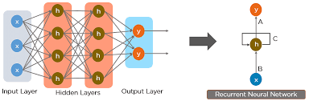
Literature Survey
Title: Recurrent Neural Network based Models for Word Prediction
Author: S.Ramya, C.S.Kaniozhi Selvi
Publication : IJRTE
Year: 2019
Presented Recurrent Neural Network model.
When neurons are connected it is known as RNN. RNN is basically used for understanding & analyzing text.
But this model is hard to train & was not good at handling large sequence of text(paragraph) so other techniques were introduced

Slide 7
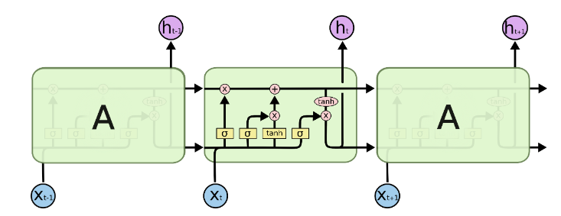
Title : Predicting next Word using RNN and LSTM cells
Author: Aejaz Farooq Ganai, Farida Khursheed
Publication: IEEE
Year: 2019
In this paper author has proposed LSTM technique.
LSTM is special kind of RNN capable of learning long term dependencies specially in sequence prediction problem.
Eg 1 : The clouds are in the sky (RNN Example)
Eg 2 : John was born in Kerala. John used to play for the men’s football team and has also topped at state-level examinations. John is very fluent in Malyalam (LSTM Technique)

Slide 8
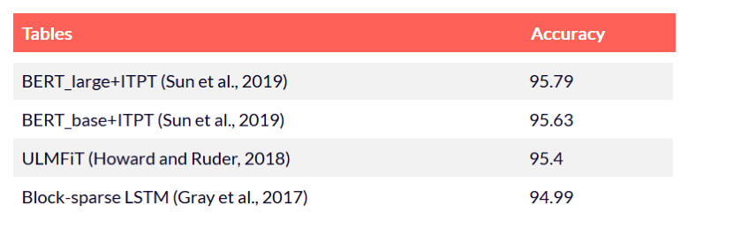
Why to use BERT over LSTM?
Initially LSTM networks had been used to solve the Natural Language Translation problem but they had a few problems. LSTM networks are : 1) Slow to train 2) It's not really the best of capturing the true meaning of words
Transformer Features :
Transformer trained in an unsupervised manner on large datasets.
It give best accuracy and also comes with less complexity and computational cost.
LSTM give better results than a BERT model for small dataset only .
If we have a data with 1000 documents per class in train set, then BERT perform better as compared to LSTM

Slide 9
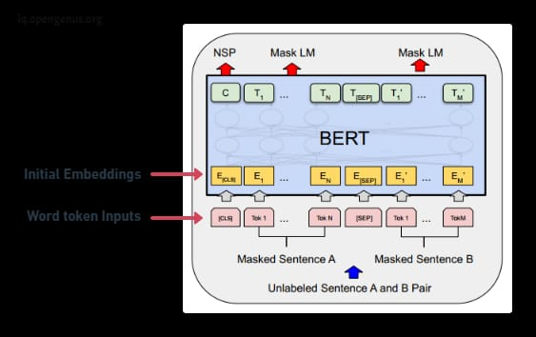
Title : A Text Generation and Prediction System: Pre-training on New Corpora Using BERT and GPT-2
Author: Yuanbin Qu, Lizhen Liu, Miaomiao Cheng
Publication: IEEE
Year: 2021
The transformer is a component used in many neural network designs for processing sequential data, such as text data
BERT is a transformer-based language model that learns the underlying representation from unlabeled text by jointly processing on both left & right context for learning.
It has 3 parts : Positional Encoding, Attention, Self-Attention(fundamental operation)
BERT learns language by training on 2 unsupervised tasks :
Mass Language Modeling & Next Sentence Prediction.
MLM teaches BERT to understand relationships between words
and NSP teaches BERT to understand longer-term dependencies
across sentences.

Slide 10
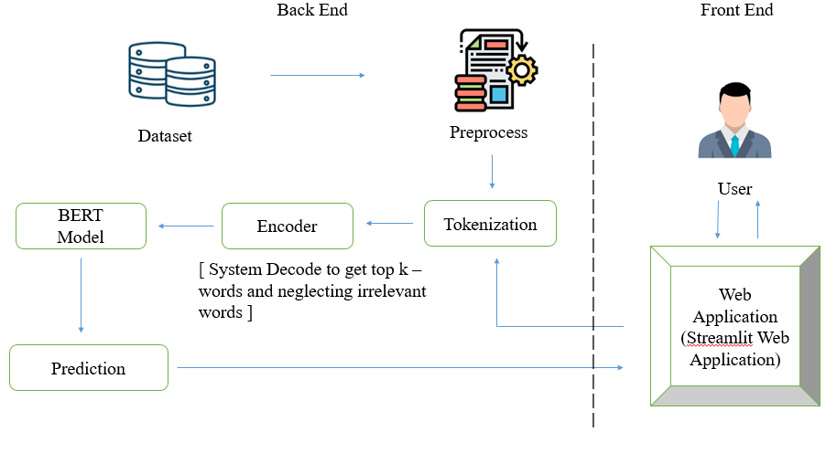
System Architecture

Slide 11
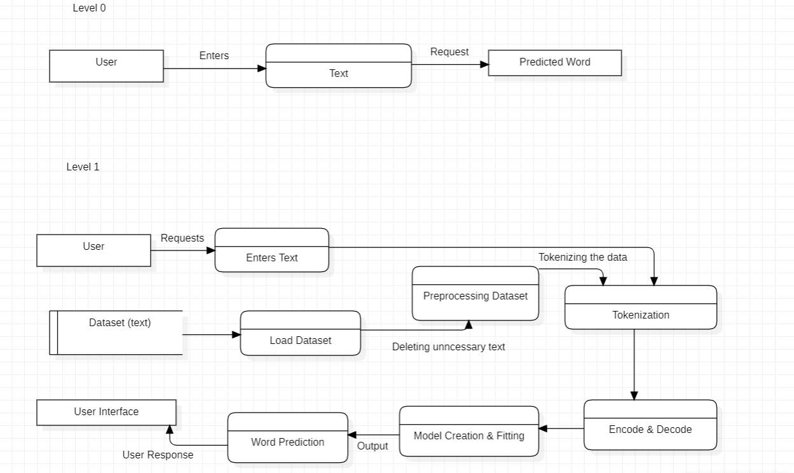
Data Flow Diagram
A data flow diagram shows the way information flows through a process or system .

Slide 12
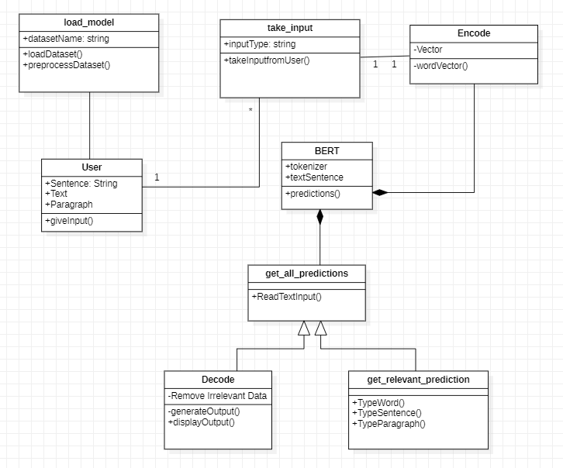
Class Diagram :
A class diagram shows classes in their relation and their properties and methods .

Slide 13
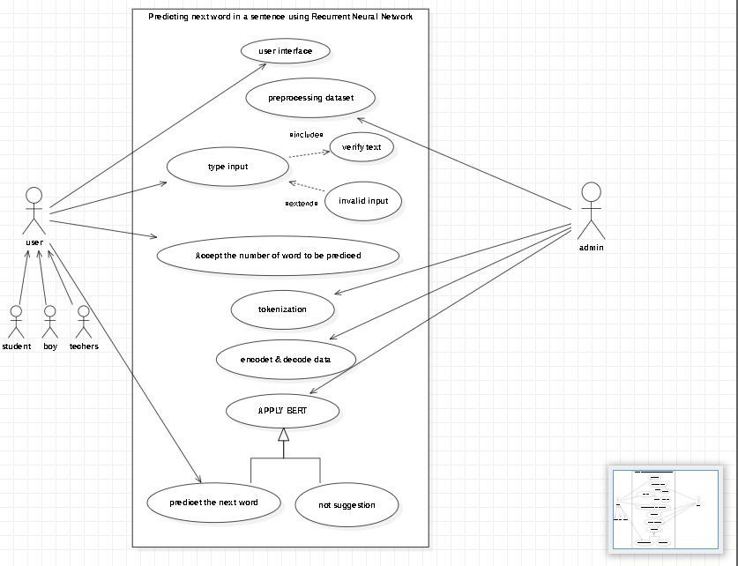
Use case Diagram :
A use case diagram is a graphical depiction of a user's possible interactions with a system.

Slide 14
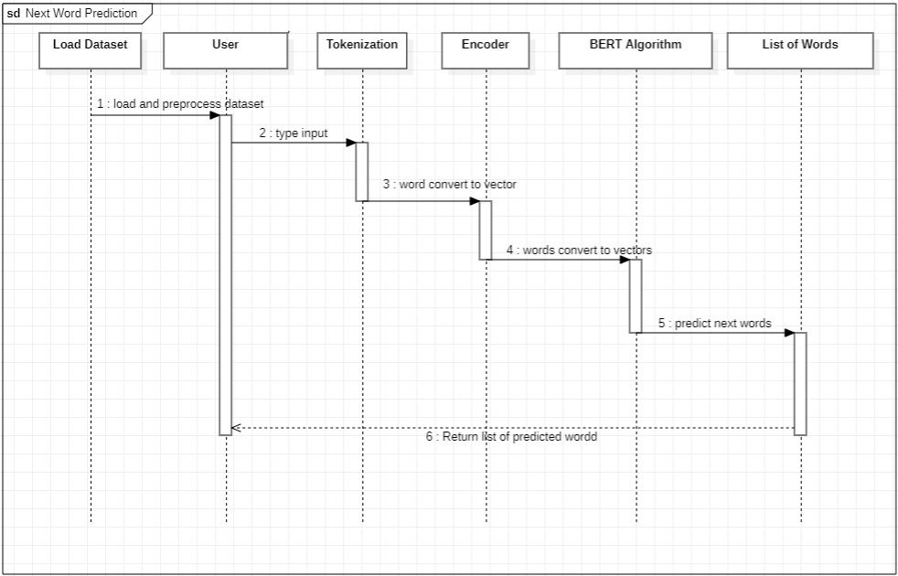
Sequence Diagram :
A sequence diagram or system sequence diagram shows process interactions arranged in time sequence in the field of software engineering.

Slide 15
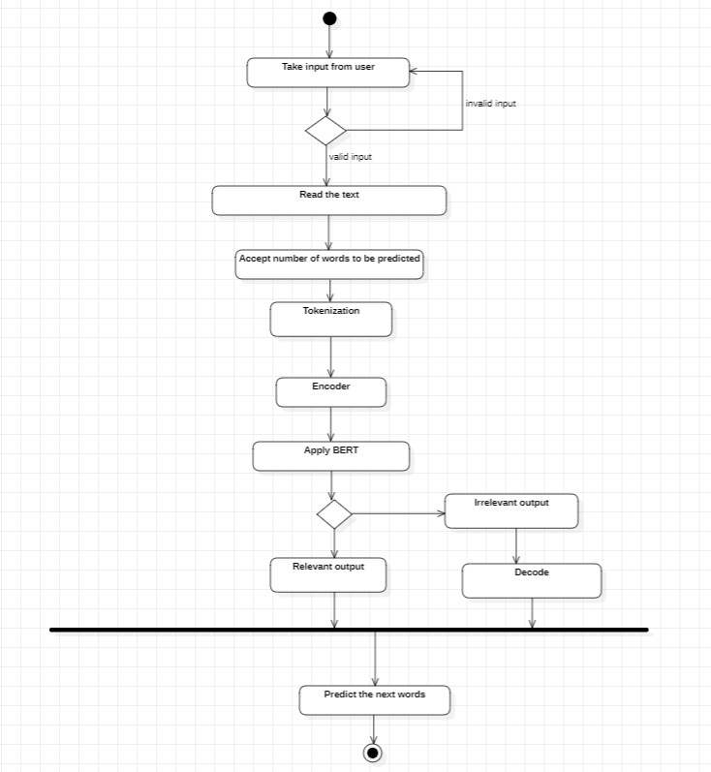
Activity Diagram :
An activity diagram visually presents a series of actions or flow of control in a system similar to a flowchart or a data flow diagram.

Slide 16
Application
Improve search efficiency
Email-writing, article writing
Children with ADHD may have problem in controlling impulsive behaviors . ADHD (Attention deficit hyperactivity disorder)
Many children with ADHD struggle with delays in motor coordination, affecting their fine motor skills
They may struggle to express their thoughts as fully as they may desire ,children with ADHD may take longer to learn to type efficiently, due to the motor component as well as possible slower processing speed and weaker working memory.
So our application will increase the efficiency of such students.

Slide 17
Feasibility
The proposed model is reliable and can be used in our day today life.
Our model is trained on paragraph & but in real life we can implement it by training it on large scale.
For large scale implementation we will use user’s search history.

Slide 18
Scope of the Project
The text prediction model based on Recurrent Neural Network system is highly essential for all individual in modern technology platforms
This system is further enhanced with benefitable features for upgrading in future. The methodology of enhancement in the automatic prediction of text are done by BERT Algorithm.
Text prediction has wide scope in many software platforms such as mobile applications, computer softwares, websites etc.

Slide 19
Thank You!

